Slide 1
Ethernet LAN and Extended LAN
Key Reference:
Peterson and Davie, “Computer Networks: A Systems Approach”, 4th Edition, Morgan Kaufmann, 2007
EE4204/TEE4204 (Part 1) Notes 5
G. Mohan / NUS

Slide 2
Medium Access Control (MAC)
Broadcast LAN (See Figure in next slide)
MAC is a sublayer of the data link layer (Layer 2)
MAC is to control access to multi-access (multiple-access or random access) channels (links, lines)
When more than one host share a channel we need MAC
Usually used in LANs
Ethernet (IEEE 802.3 standard) (popularly used)
Token ring (802.5, FDDI) (not popular now)
Wireless (802.11) (popularly used)
EE4204/TEE4204 (Part 1) Notes 5
G. Mohan / NUS

Slide 3
Ethernet Broadcast LAN
Shared bus – 10 Mbps
10 Mbps
10 Mbps
10 Mbps
10 Mbps
A
B
C
D
EE4204/TEE4204 (Part 1) Notes 5
G. Mohan / NUS

Slide 4
Ethernet Cabling
In traditional Ethernet, hosts are connected to Ethernet cable (shared bus) through adapters
  Coaxial cable, half-duplex, Up to 10 Mbps,
Length: Max 2500m
  There can be at most 5 segments (length up to 500 m)separated by 4 repeaters.
Later hub and switch based Ethernet evolved
  Eg: twisted-pair cable based star-connected hub
See the table in the next slide which lists a few types of Ethernet and features
EE4204/TEE4204 (Part 1) Notes 5
G. Mohan / NUS

Slide 5
Different kinds of Ethernet LANs
Baseband: low-pass, non-modulated very low frequency signal
Name (10Mbps) | cable | Max segment | Nodes/ segment
10Base5 | Thick coax | 500 m | 100
10Base2 | Thin coax | 200 m | 30
10Base-T | Twisted pair | 100 m | 1024
10Base-F | Fiber optics | 2000 m | 1024
EE4204/TEE4204 (Part 1) Notes 5
G. Mohan / NUS

Slide 6
Ethernet Frame Format
Manchester encoding is used (Later 4B/5B & others as well)
  Low-to-high transition to encode a 0 and high-to-low transition to encode a 1
  1: transmit high signal followed by low signal
  0: transmit low signal followed by high signal
Preamble
  7 bytes (10101010) used for clock synchronization
  1 byte (10101011) used to mark the start of frame
Type (or length)
  Used as a demultiplexing key. Usually >1500
    (eg: VLAN frame, ARP frame)
  Can also be used as a length field (0 to 1500 bytes)
  Frame format showing fields and their size (in bits)
64
48
48
16
32
Preamble
Dest
Src
Type or
Len
Body
CRC
addr
addr
EE4204/TEE4204 (Part 1) Notes 5
G. Mohan / NUS

Slide 7
Ethernet Addresses
Addresses
  Unique world-wide, 48-bit unicast address assigned to each adapter
  example: 08:c0:65:b1:2a:5d
  broadcast: all 1s: ff: ff: ff: ff: ff: ff
  multicast: first bit is 1 (the rightmost bit of the most significant byte)
    First byte is the most significant byte
Ethernet adapter receives all frames and accepts
  Frames addressed to it
  Frames addressed to the broadcast address
  Frames addressed to a multicast address if instructed
  All frames if it operates in promiscuous mode (eg: Ethernet switch)
EE4204/TEE4204 (Part 1) Notes 5
G. Mohan / NUS

Slide 8
CSMA - CD
Ethernet uses CSMA-CD technique
CSMA-CD: carrier sense multiple access – collision detection
Carrier sense
  A host senses the link and can distinguish if the link is idle or busy (if there is any signal transmission going on the link or not)
Collision detect
  A host listens what it is transmitting and therefore can detect if it collides with any other frame transmitted by some other host
EE4204/TEE4204 (Part 1) Notes 5
G. Mohan / NUS

Slide 9
1-Persistent CSMA
p-persistent CSMA
  If a host is ready to send a frame, it continuously senses the channel (link). If it is idle, then transmit frame with probability p
1-persistent CSMA
  If a host is ready to send a frame, it continuously senses the channel (link). If it is idle, then transmit frame with probability 1
  Ethernet uses 1-persistent protocol
EE4204/TEE4204 (Part 1) Notes 5
G. Mohan / NUS

Slide 10
Transmit Algorithm
A node (host) can transmit independent of what other nodes (hosts) are doing.
uses exponential backoff algorithm to dynamically adapt to the number of nodes (hosts) trying to send
  To estimate the number of active hosts in the event of collisions
If line (link) is idle…
  send immediately
  upper bound message size of 1500 bytes
If line (link) is busy…
  wait until idle and transmit immediately
EE4204/TEE4204 (Part 1) Notes 5
G. Mohan / NUS

Slide 11
Transmit Algorithm (contd.)
If collision…
  Transmit a 32 bit jamming sequence (noise burst) along with 64 bit preamble, then stop transmitting frame (Why jam signal?)
  delay and try again
  1st collision: waits for n slots where n is chosen randomly from the interval [0,1], 1 slot is usually 51.2μs
  2nd consecutive collision: waits for n slots where n is chosen randomly from the interval [0,3]
  i^{th} consecutive collision: waits for n slots where n is chosen randomly from the interval [0,2^{i} -1]
    for i > 10, the interval used is [0,2 ¹⁰ –1]
    give up after several tries (usually 16)
EE4204/TEE4204 (Part 1) Notes 5
G. Mohan / NUS

Slide 12
Minimum frame size
Minimum size is 64 bytes: 14 bytes header 46 bytes data, and 4 bytes CRC (WHY?) A situation should not arise wherein, the sending host has transmitted the frame, without detecting any collision, but there is actually a collision
From the Figure (shown in next slide, see reference book Peterson and Davie), it is observed that a host needs to send for “RTT” to detect all possible collisions (Tf >= RTT)
  Host A finds the link is free and sends a frame
  Just before the arrival of frame bits, host B finds that the link is free and starts transmitting a frame
  Collision occurs near host B’s link interface which is detected by Host B; jam signal is sent by host B
  If host A does not transmit its frame for “RTT”, it cannot detect collision
    Because it has stopped frame transmission when the jam signal reaches
Ethernet length is limited to 2500 m and four repeaters; for this case RTT is estimated to be bound by 51.2μs = 512 bits (64 bytes) for 10 Mbps Ethernet
  Tf = size/B
[Why jam signal?] If host B terminates its transmission after sending only a very few bits without jam sequence, host A may not receive sufficient energy to detect collision
EE4204/TEE4204 (Part 1) Notes 5
G. Mohan / NUS

Slide 13
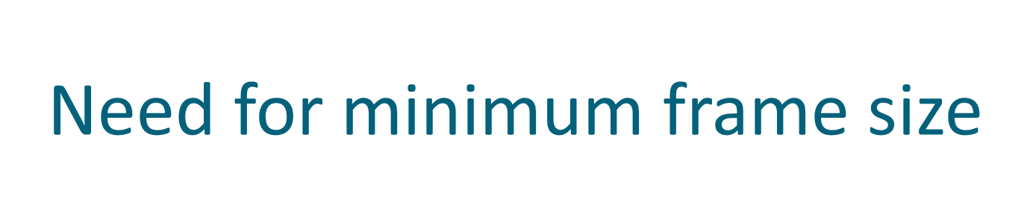
A
B
A
B
A
B
A
B
EE4204/TEE4204 (Part 1) Notes 5
G. Mohan / NUS

Slide 14
LAN Hubs and Switches
Shared-Medium Bus (also referred to as a bus)
  popular from late 1970s to early 1990s
Shared-Medium Hub (also referred to as a hub)
  popular from late 1990s
Switching Hub (also referred to as a switch)
  popular from early 2000s
EE4204/TEE4204 (Part 1) Notes 5
G. Mohan / NUS

Slide 15
Bus-based LAN
Shared-Medium Bus (or simply a bus)
  Bus configuration
  Traditional Ethernet (e.g. 10BASE 5)
  Single collision domain
    Set of nodes (hosts) wherein a frame sent by a node can possibly collide with frames sent by any other node
  10 Mbps Bus LAN
    10Mbps shared by all hosts; total no of bits transmitted by all hosts in one second is at most 10 million
  All stations (hosts) share the total capacity of the LAN or bus
  One station transmits, others receive
  Cable cut disconnects the network
EE4204/TEE4204 (Part 1) Notes 5
G. Mohan / NUS

Slide 16
Bus LAN
Shared bus – 10 Mbps
10 Mbps
10 Mbps
10 Mbps
10 Mbps
A
B
C
D
EE4204/TEE4204 (Part 1) Notes 5
G. Mohan / NUS

Slide 17
Hub-based LAN
Shared-Medium Hub (or simply a hub)
  Star configuration, e.g. 10BASE-T Ethernet
  E.g. 802.3u 100 Mbps Fast Ethernet (e.g. 100 BASE T)
  When a frame is received on a port, the hub copies it to all the other ports
  Single collision domain, hub transmits jam signal to all when collision occurs
  All stations share the total capacity of the LAN or hub
    10 Mbps Hub LAN: 10Mbps shared by all hosts; total no of bits transmitted by all hosts in one second is at most 10 million
  One station transmits, others receive
  Can exploit building wiring practices for cable layout
  Hub can recognize a malfunctioning station that jams the network and remove it from the network
  Cable cut does not disconnect the network
EE4204/TEE4204 (Part 1) Notes 5
G. Mohan / NUS

Slide 18
Hub LAN
Total capacity
up to 10 Mbps
10 Mbps
10 Mbps
10 Mbps
10 Mbps
A
B
C
D
EE4204/TEE4204 (Part 1) Notes 5
G. Mohan / NUS

Slide 19
Switch-based LAN
Switching Hub (or simply a switch)
  Star configuration
  E.g. 802.3u 100 Mbps Fast Ethernet (e.g. 100 BASE T)
  E.g. 802.3z Gigabit Ethernet (e.g. 1000 BASE SX, 1000 BASE LX)
    SX: short wavelength 0.85 micron, multimode fiber
    LX: long wavelength 1.3 micron, single mode fiber
  Store and Forward Packet Switch, use buffer to keep the excess frames
  No collision between ports, Port is the collision domain, when only one station is connected to a port, there is no collision
  More than one pair can communicate simultaneously.
    Switch with N 10-Mbps ports: Total no of bits transmitted by all hosts in one second is at most N×10 million
  Cable cut does not disconnect the network
  Without any change in hardware or software of the attached stations, a bus LAN can be converted into a hub LAN or to a switch LAN.
EE4204/TEE4204 (Part 1) Notes 5
G. Mohan / NUS

Slide 20
Switch LAN
Total capacity
N x10 Mbps
10 Mbps
10 Mbps
10 Mbps
10 Mbps
A
B
C
D
EE4204/TEE4204 (Part 1) Notes 5
G. Mohan / NUS

Slide 21
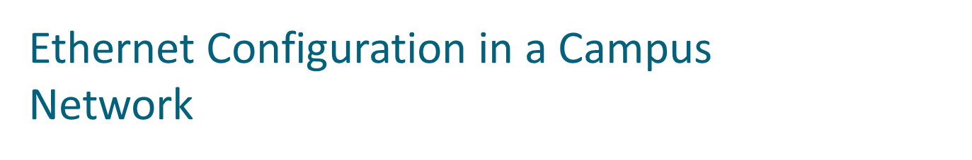
1 Gbps
switch
1 Gbps link
server
server
100 Mbps link
server
10 Mbps link
100/1000 Mbps
switch
10/100 Mbps
switch
10 Mbps
hub
EE4204/TEE4204 (Part 1) Notes 5
G. Mohan / NUS

Slide 22
Bridges and Extended LANs
LANs have physical limitations (e.g., 2500m)
Extended LAN: Interconnection of two or more LANs by one or more bridges
Note: LAN bridges and switches are similar. In this lecture notes, they can be used interchangeably.
  Switches (e.g. Ethernet switches) operate at layer 2. Routers (e.g. IP routers) also perform switching function but operate at layer 3 with more intelligent routing techniques
Source routing bridge
  Source host attaches complete address to the destination to the frame header ; token ring 802.5 group
Transparent bridge or Spanning Tree bridge
  Hosts need (do) not have the knowledge of the presence of bridges; CSMA/CD 802.3 group; WE STUDY TRANSPARENT BRIDGES
A bridge (switch)
  Operates in promiscuous mode; Multi-input and multi-output switch
  An Ethernet bridge connecting n number of 10 Mbps Ethernet segments can carry up to 10n Mbps traffic
  Operates in the data link layer. Uses accept and forward strategy; does not add packet header
EE4204/TEE4204 (Part 1) Notes 5
G. Mohan / NUS

Slide 23

A
B
C
Port 1
Bridge
Port 2
X
Y
Z
EE4204/TEE4204 (Part 1) Notes 5
G. Mohan / NUS

Slide 24
Learning Bridges
Learn the ports through which a given host can be reached
Maintain forwarding table
Host Port A 1 B 1 C 1 X 2 Y 2 Z 2
Learn table entries based on source address
Table need not be complete; can dynamically change (Why?)
Always forward broadcast frames
A
B
C
Port 1
Bridge
Port 2
X
Y
Z
EE4204/TEE4204 (Part 1) Notes 5
G. Mohan / NUS

Slide 25
Backward Learning Method
Initially the forwarding table is empty
When the bridge sees a frame <A,B> with source A and destination B, it learns where A is; i.e. through which port/interface A can be reached. Since the location of B is not known, the frame is forwarded through all the other ports; here port 2; as the frame was received from port 1. An entry for A is made in the table.
When <Y,A> is received, it is forwarded to port 1 as the bridge has already learnt A’s location. Now the bridge learns Y’s location and makes an entry in the forwarding table.
When <B,Z> is received, the port associated with B is learnt. Frame is forwarded to all the other ports; in this case, through port 2
When <C,B> is received, the port associated with C is learnt the bridge does not forward it to port 2 as it already knows that B is on port 1.
A
B
C
Port 1
Bridge
Port 2
X
Y
Z
EE4204/TEE4204 (Part 1) Notes 5
G. Mohan / NUS

Slide 26
Loops - Problem
A
B1
B2
B
Loops can exist to increase reliability but it may result in a situation where frames loop forever
When frame F with unknown destination arrives at LAN B, B1 forwards it to LAN A generating frame F1, B2 forwards to LAN B generating frame F2. B1 on seeing F2 will forward it to LAN A generating F3. Similarly B2 on seeing F1 will forward it to LAN B generating F4. This continues forever.
EE4204/TEE4204 (Part 1) Notes 5
G. Mohan / NUS

Slide 27
Spanning tree Bridges
To avoid loops, generate a spanning tree topology over the actual topology
  Graph: A set of nodes and edges
  Spanning tree of a graph: subgraph with all nodes and a subset of edges; no loops; unique path from the root to any node; unique path between any two nodes (eg: trees T1 and T2 in the next slide, root: node 1)
  Shortest path spanning tree: formed by shortest paths from the root to every other node (eg.: tree T1 in the next slide; root: node 1)
The spanning tree spans all the LANs; but some bridges (or ports) may be (logically) removed to avoid loops
There is a unique path between any two LANs
Using a distributed spanning tree algorithm all bridges agree on the spanning tree
  select which bridges on which ports actively forward
  developed by Radia Perlman
  now IEEE 802.1 D specification
EE4204/TEE4204 (Part 1) Notes 5
G. Mohan / NUS

Slide 28
SPANNING TREE : EXAMPLE
1
1
graph G
1
s.tree T1 of G. Shortest path spanning tree.
Node 1 is the root.
s.tree T2 of G
Node 1 is the root.
EE4204/TEE4204 (Part 1) Notes 5
G. Mohan / NUS

Slide 29
Spanning Tree Algorithm Overview
Each bridge has unique id (e.g., B1, B2, B3) (See figure - Ref book by Peterson and Davie)
Select bridge with smallest id as root
Create a tree of shortest paths from every bridge to the root
Select bridge on each LAN closest to root as designated bridge (use id to break ties)
Forward frames following the spanning tree.
A
B3
B
Each bridge forwards frames over each LAN for which it is the designated bridge
C
B5
B2
D
B7
K
E
F
B1
G
H
B6
B4
I
J
EE4204/TEE4204 (Part 1) Notes 5
G. Mohan / NUS

Slide 30
Algorithm Details
Bridges exchange configuration messages:(Y,d,X)
  Id (X) for bridge sending the message
  id (Y) for what bridge X believes to be root bridge
  distance (hops) (d) from sending bridge to root bridge
Each bridge records current best configuration message for each port
Initially, each bridge believes it is the root
  Send (X,0,X)
EE4204/TEE4204 (Part 1) Notes 5
G. Mohan / NUS

Slide 31
Algorithm Detail (contd.)
When learn not root, stop generating config messages
  in steady state, only root generates configuration messages
When learn not designated bridge, stop forwarding config messages
  in steady state, only designated bridges forward config messages
Root continues to periodically send config messages
If any bridge does not receive config message after a period of time, it starts generating config messages claiming to be the root
EE4204/TEE4204 (Part 1) Notes 5
G. Mohan / NUS

Slide 32
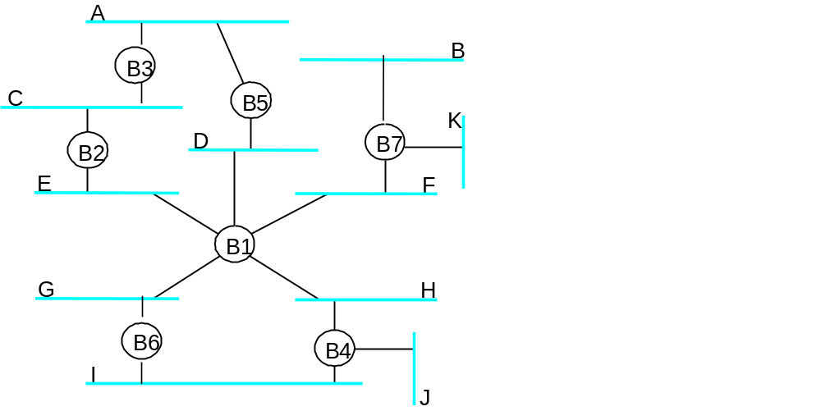
Spanning Tree Algorithm: An illustration
B3 receives (B2, 0, B2) on LAN C
  B3: accepts B2 as root since 2<3; sends (B2, 1, B3) to B5 on LAN A
B2 receives (B1, 0, B1) on LAN E
  B2 accepts B1 as root; sends (B1,1,B2) to B3 on LAN C
B5 receives (B1, 0, B1) on LAN D
  B5 accepts B1 as root; sends (B1,1,B5) to B3 on LAN A
B3 receives (B1, 1, B2) from B2 on LAN C
  B3 accepts B1 as root;
  stops forwarding to LAN C as B2 is closer to B1 than itself
B3 receives (B1, 1, B5) from B5 on LAN A.
  B3 accepts B1 as root; stops forwarding to LAN A as B5 is closer to B1 than itself
EE4204/TEE4204 (Part 1) Notes 5
G. Mohan / NUS

